Slide 1
Latest Hud aka PerspectiveΔ
By Von’Erik
… of course.

Slide 2



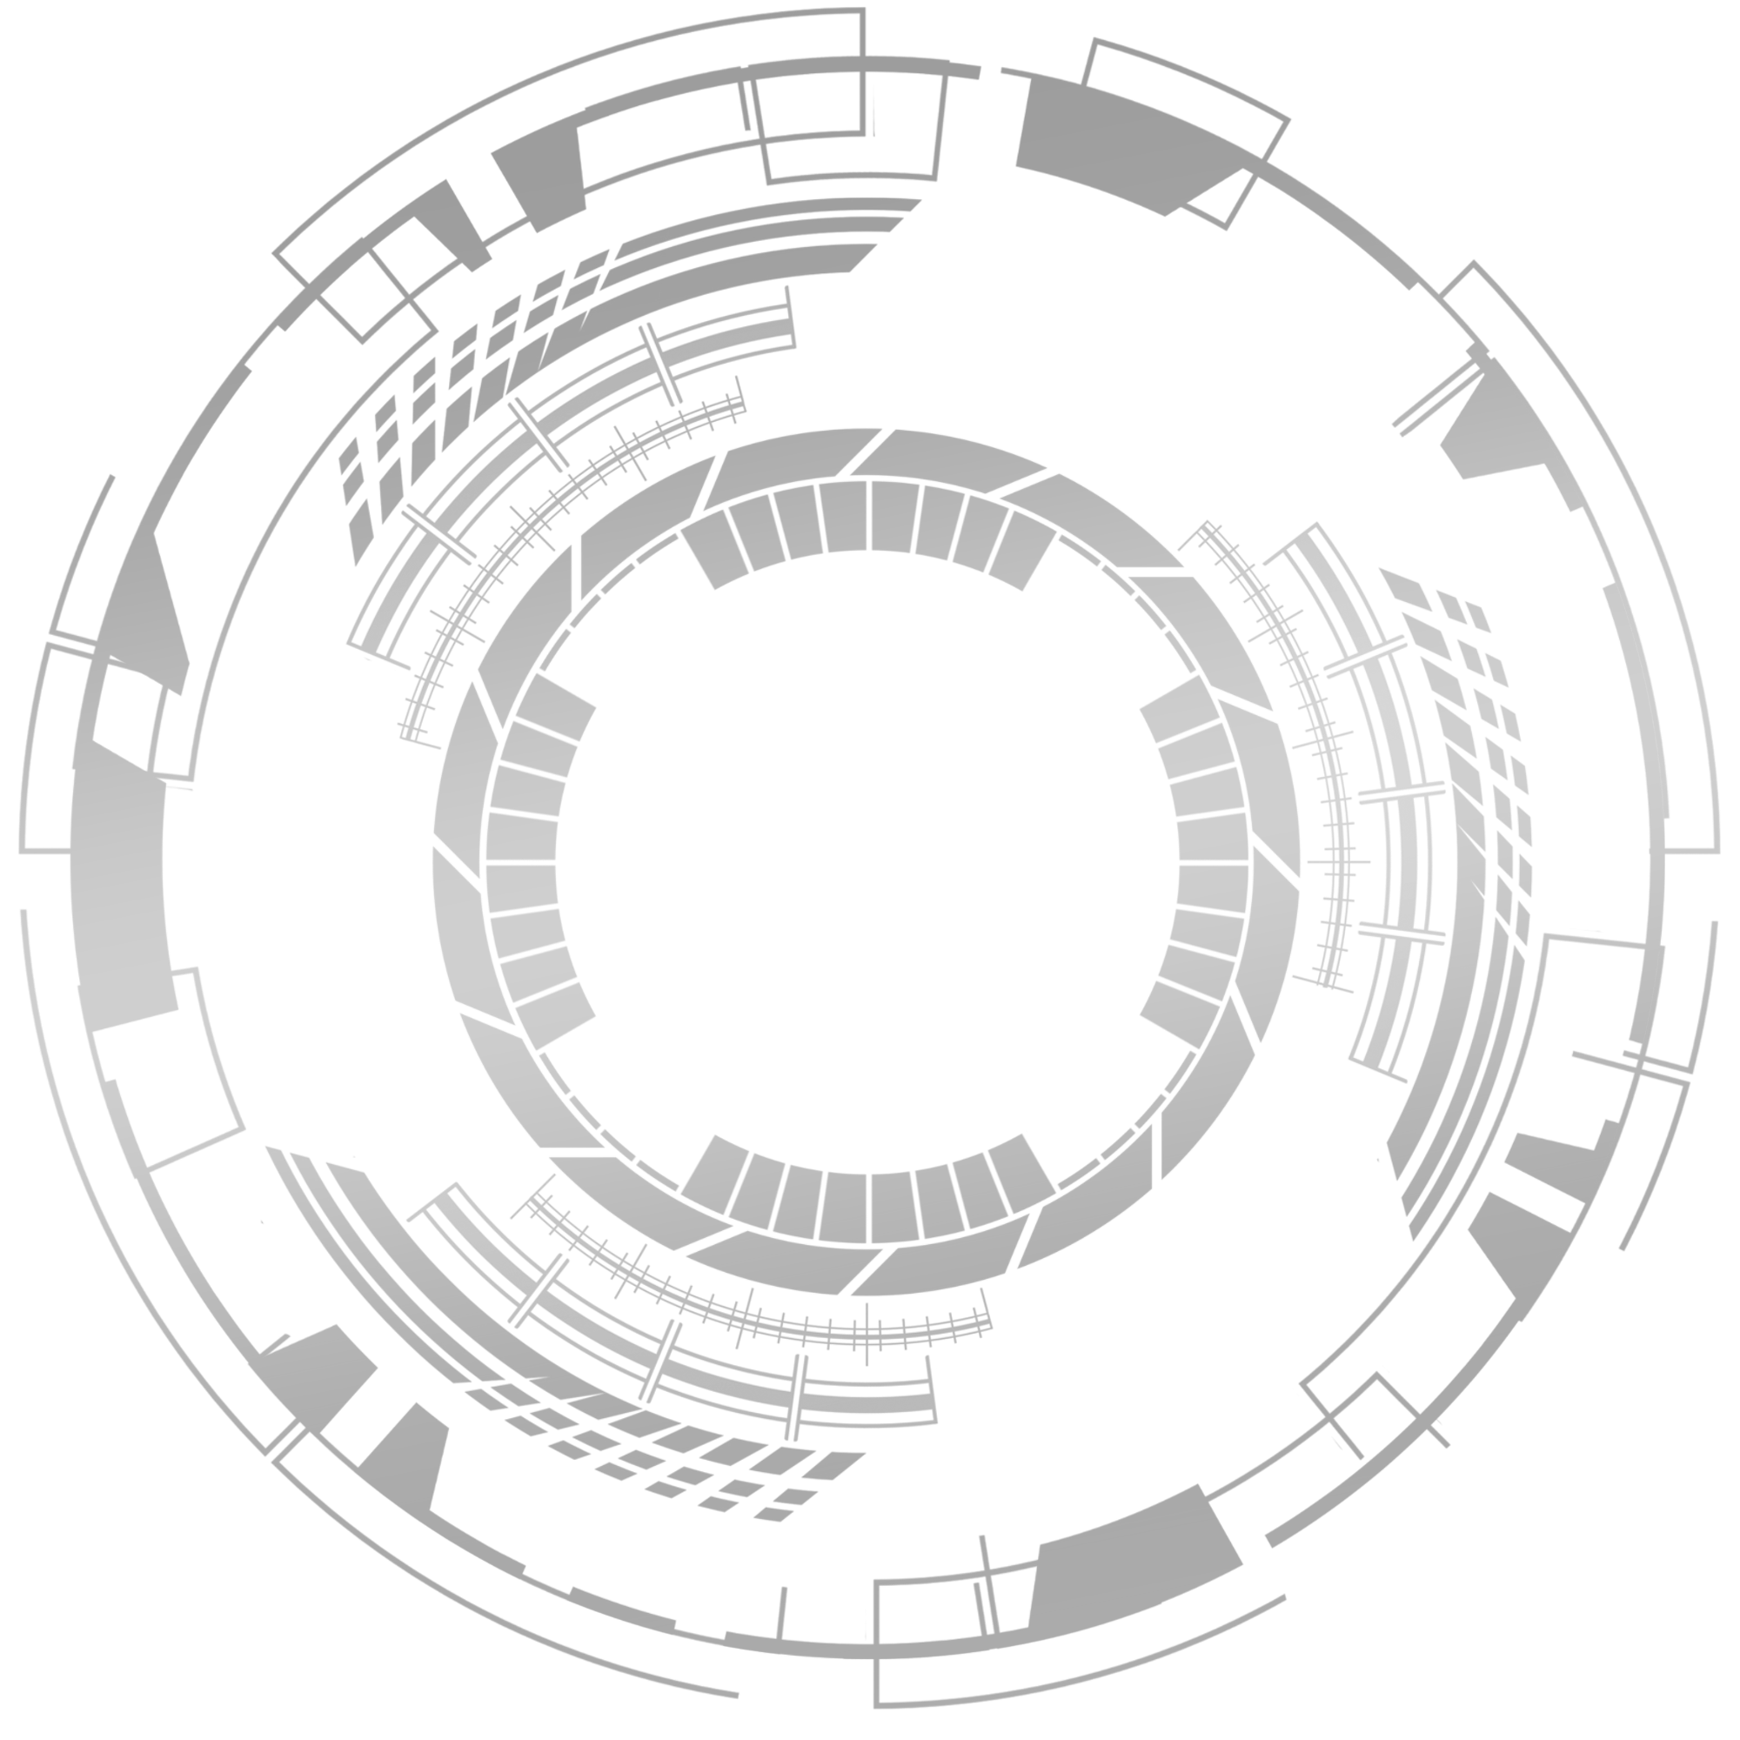
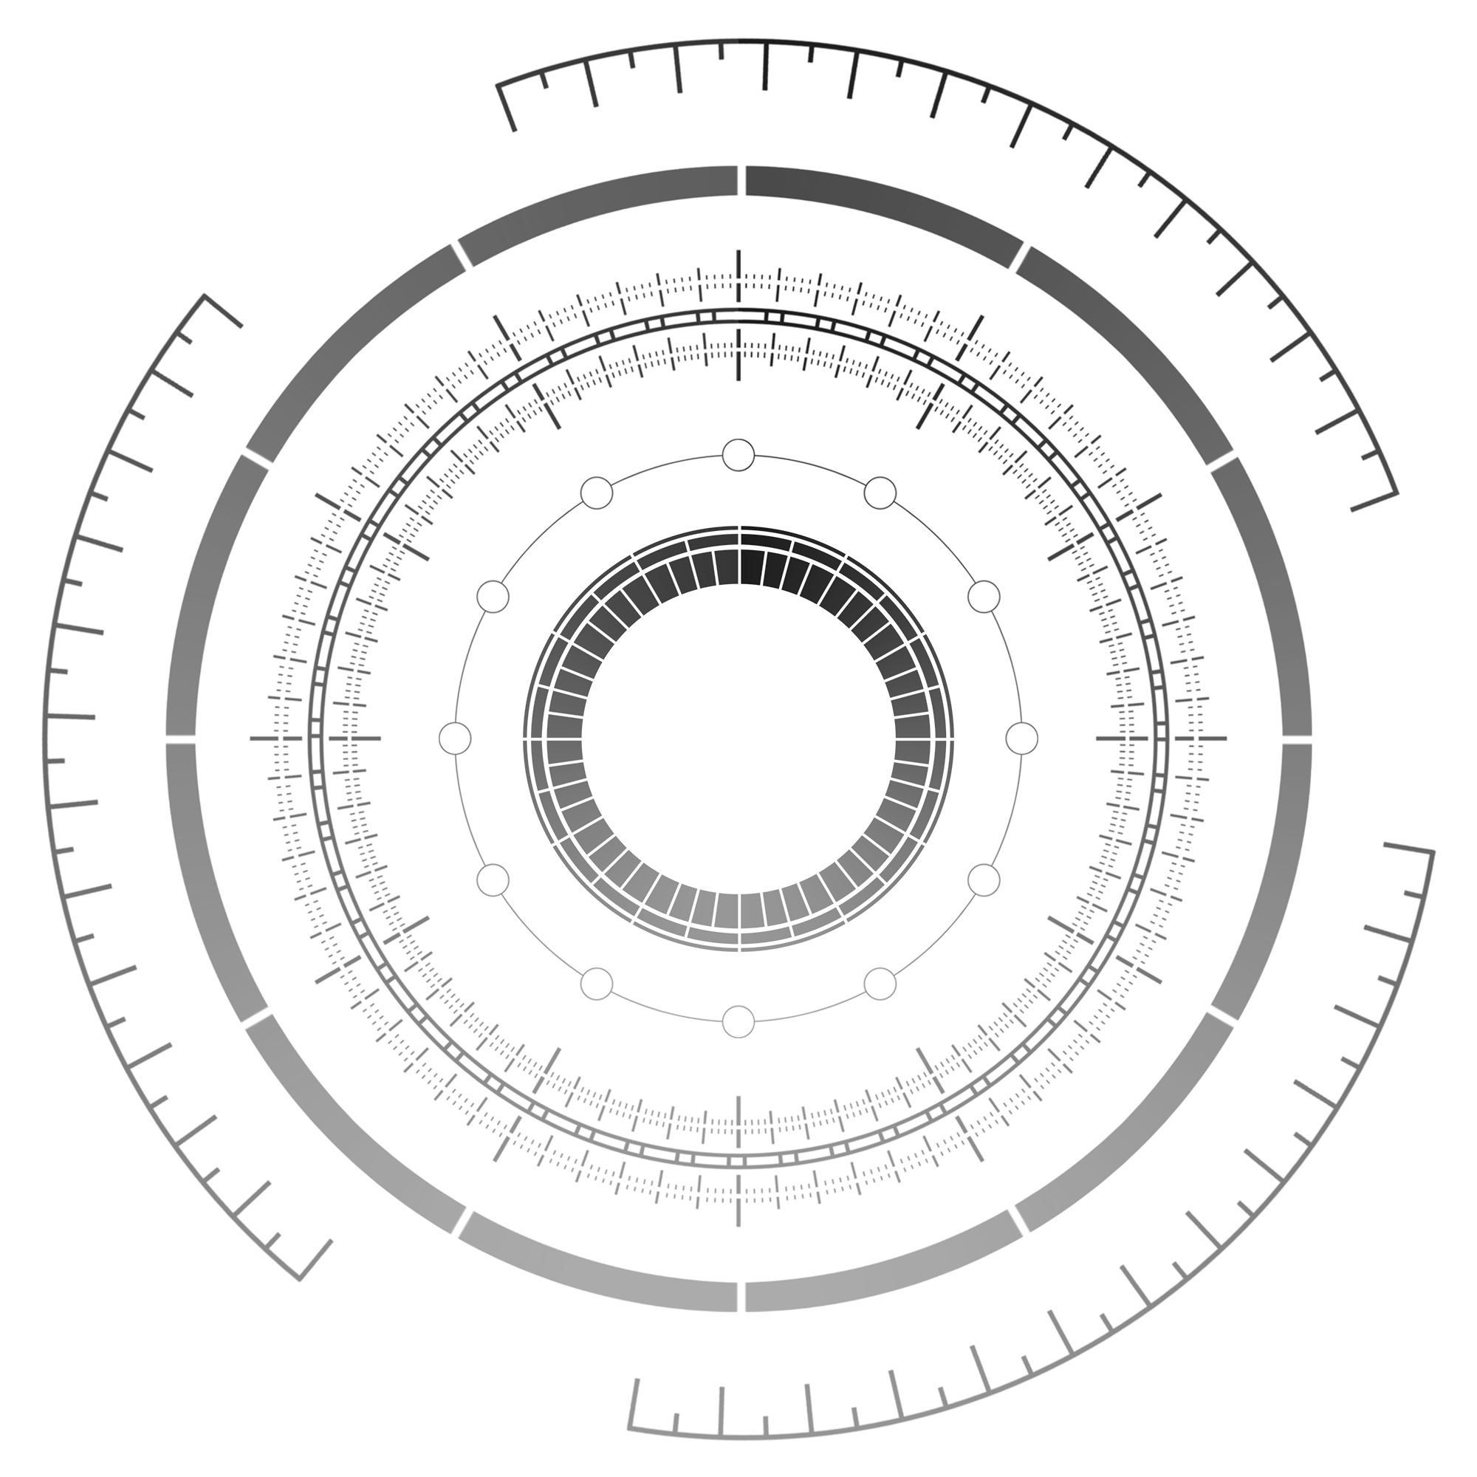


_ΘΔ_
_ΠΔ_
_ΑΔ_
_QΔ_
_SΔ_

Slide 4







Slide 5
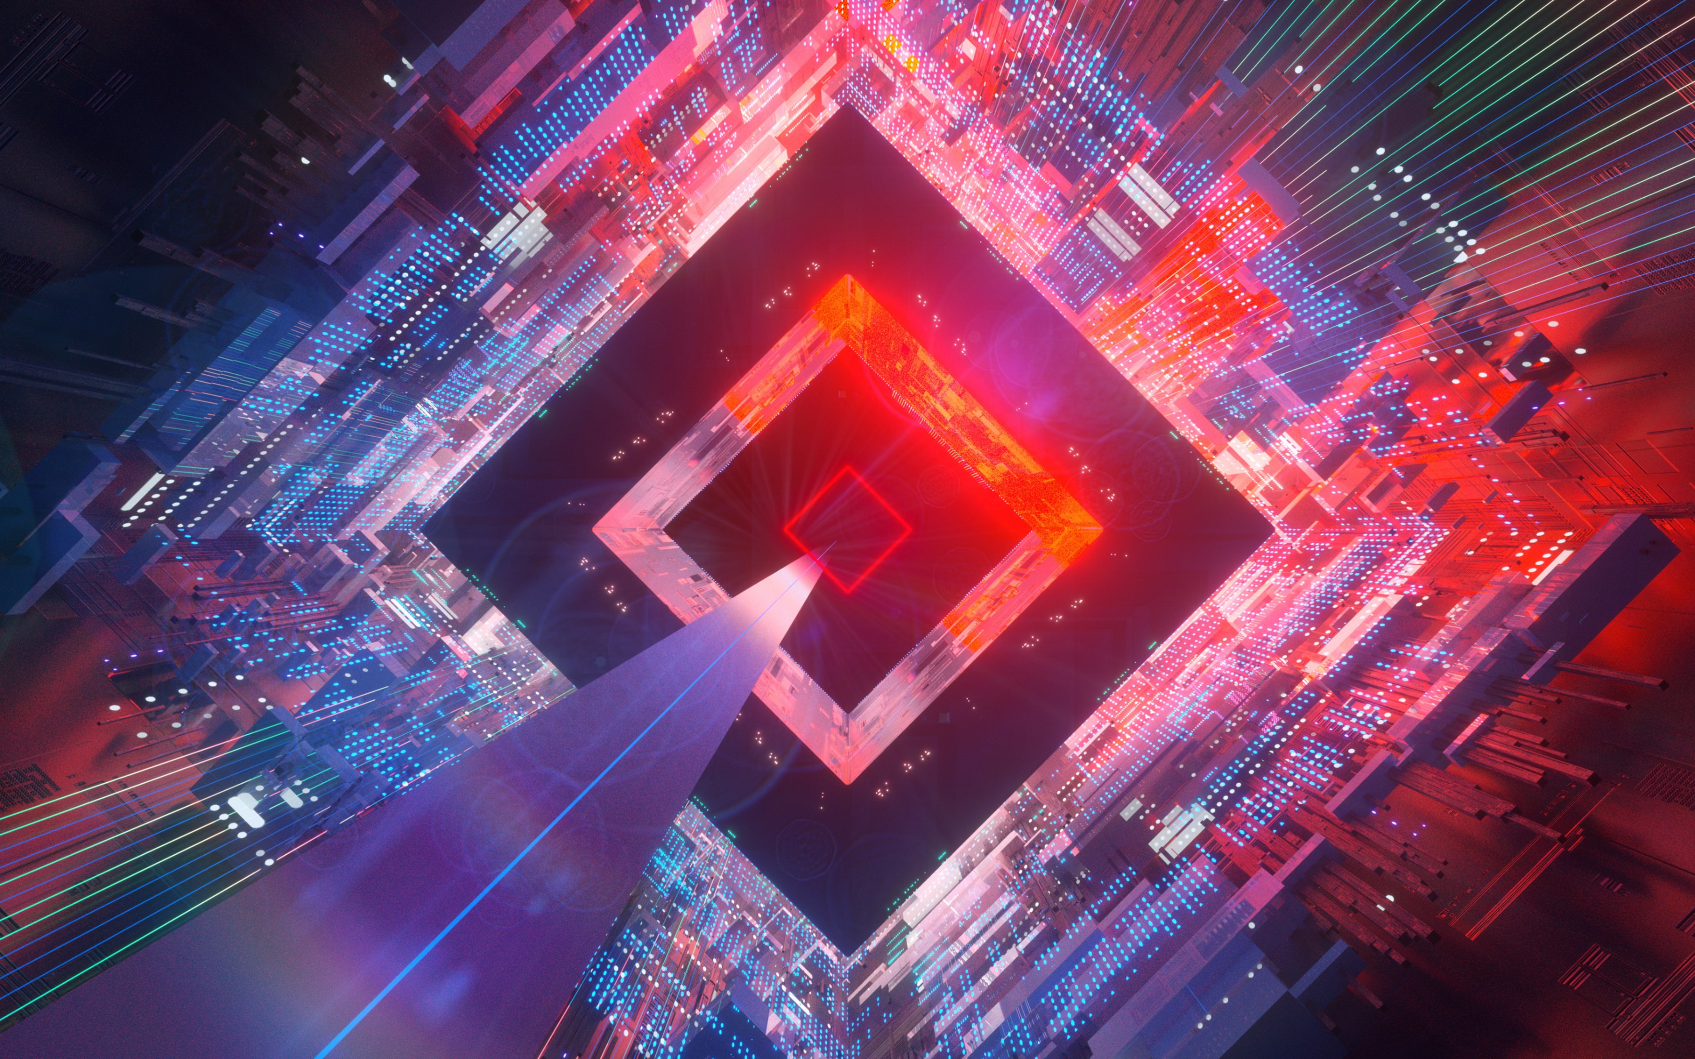

Slide 7


Slide 8







Slide 11







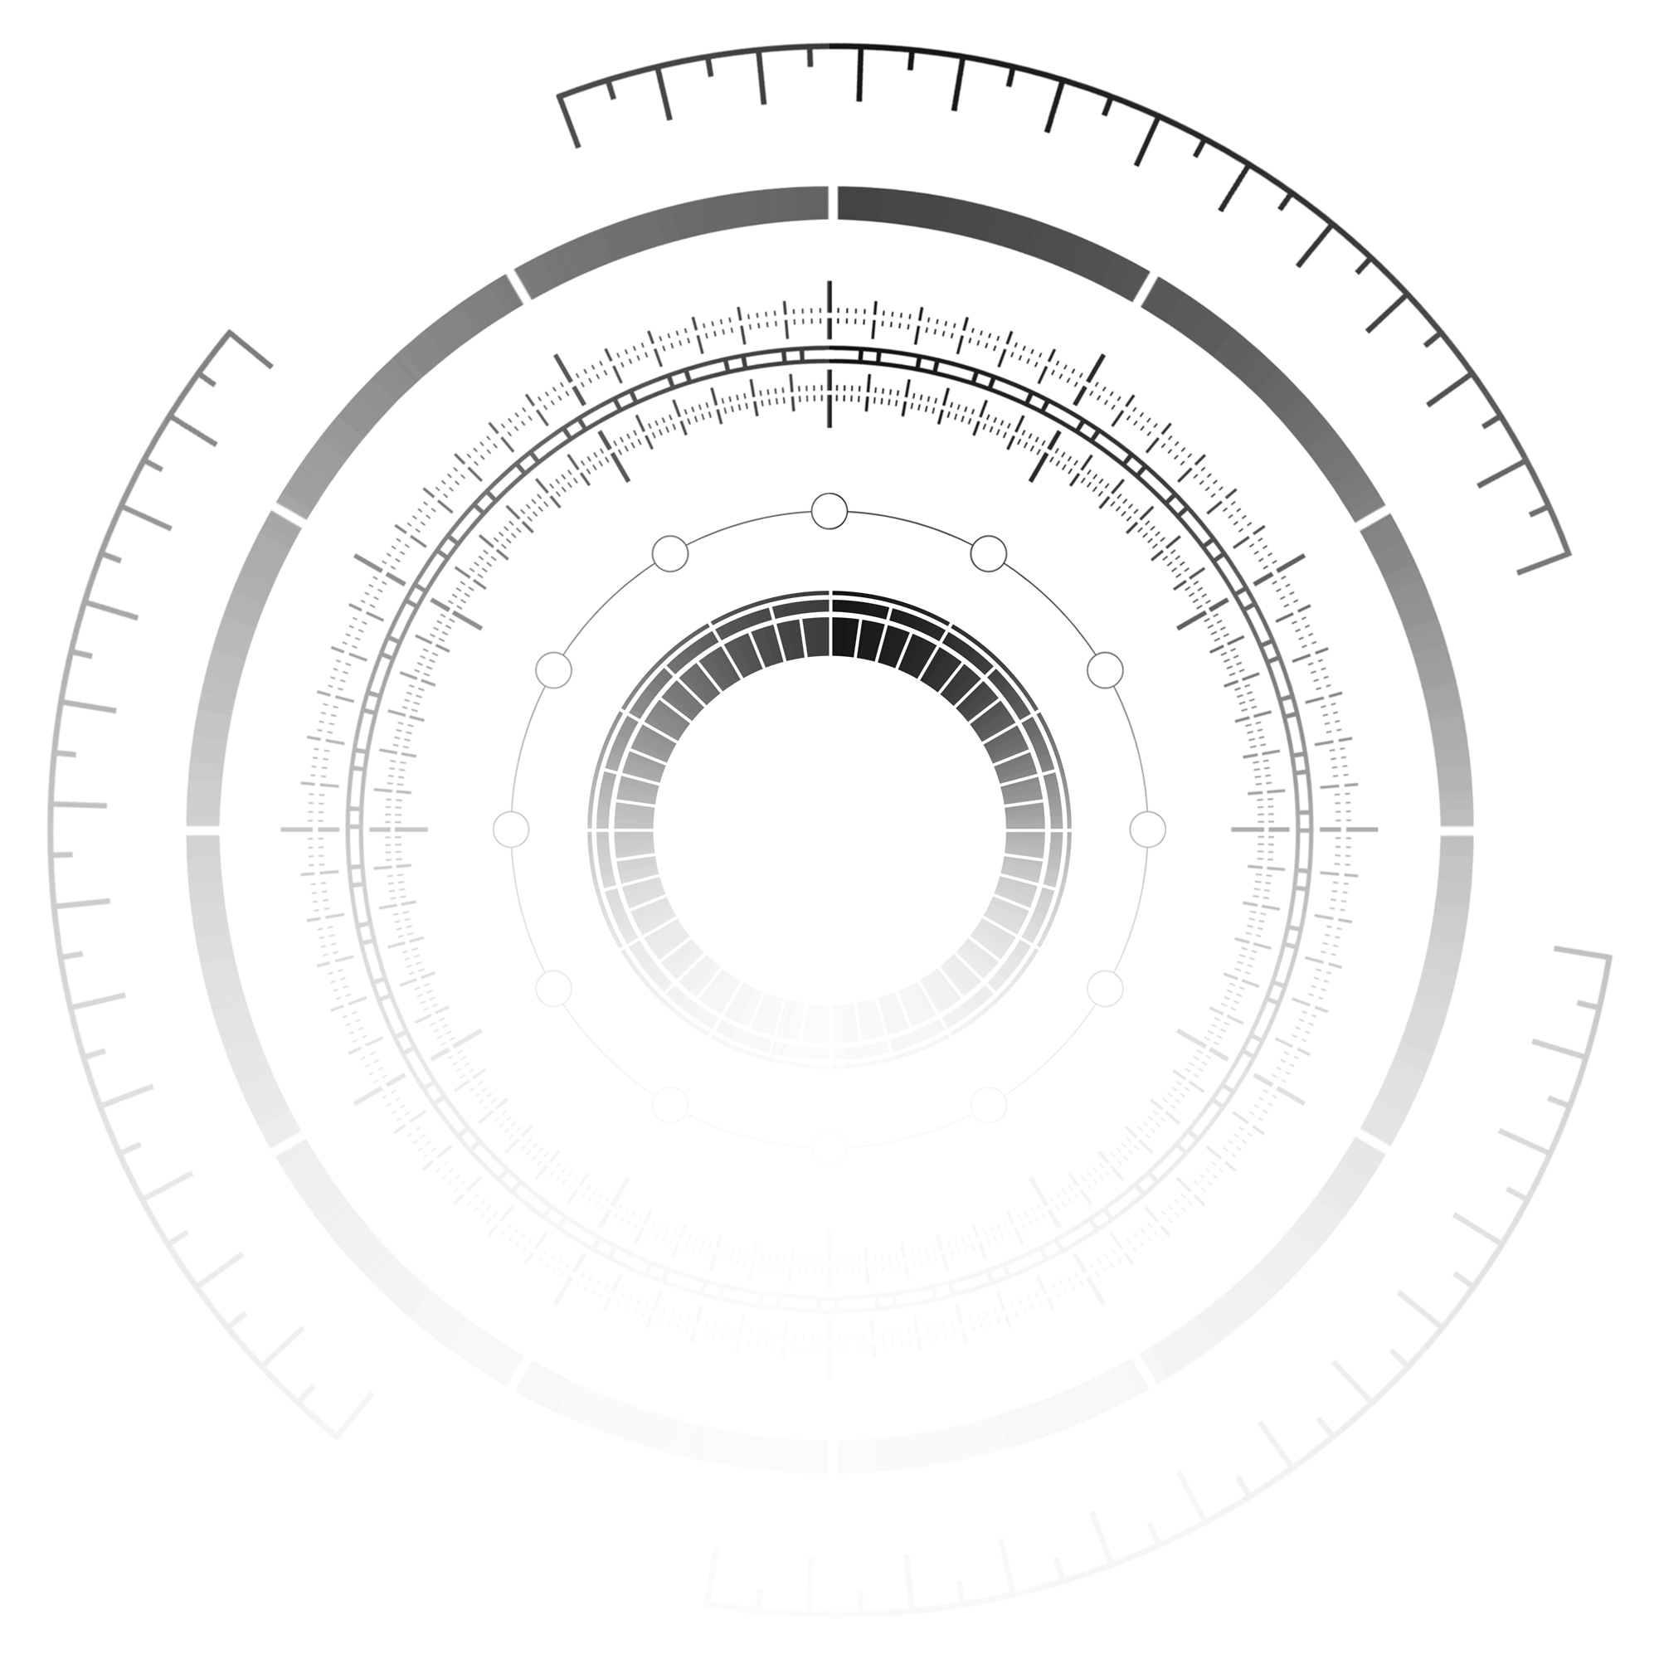

Slide 12



Slide 14
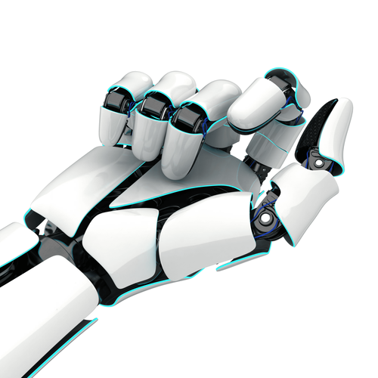

Slide 15
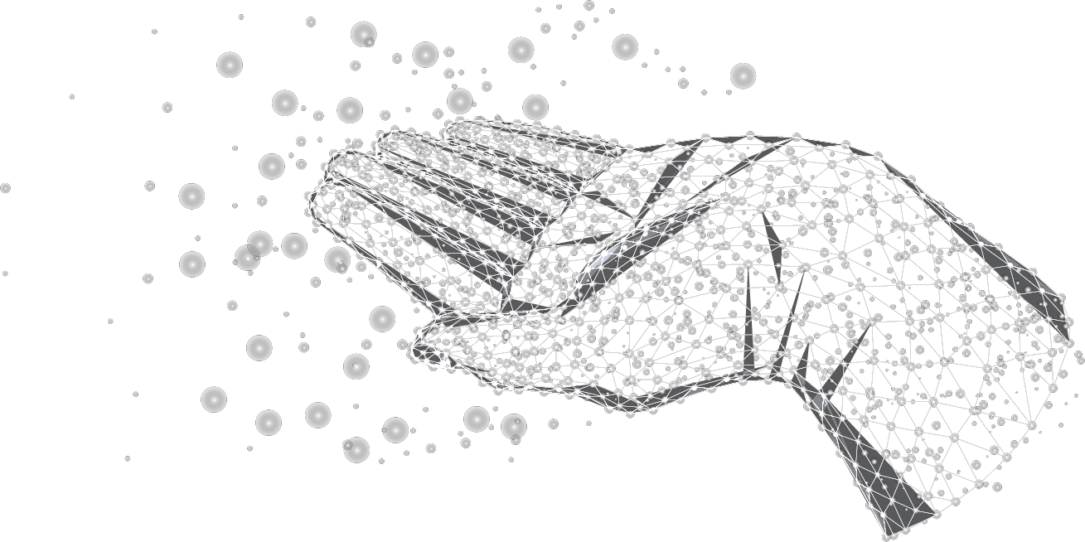

Slide 17


Systems
User
L-Brain
R-Brain
Design
Create
Notes:
# Left_Hand_TopDrawer_Menu_Options
# Left_Hand_TopDrawer_Menu01__System
|- System_RealitiesManager_Δ
|- System_HUD_Manager_Δ
|-
# Left_Hand_TopDrawer_Menu02__User
|- user_PerspectiveManagerΔ
|- user_LocationManagerΔ
|- user_HeightManagerΔ
|- user_SpeedManagerΔ
# Left_Hand_TopDrawer_Menu03__L-Brain
|- L_Brain__Objects_and_Variables
|- L_Brain__Structural_Perspectives
|- L_Brain__Time_and_Relativity
|- L_Brain__Hierarchies
|- L_Brain__Contrasts_and_Spectrums
|- L_Brain__Properties
|- L_Brain__Eurekas

Slide 18
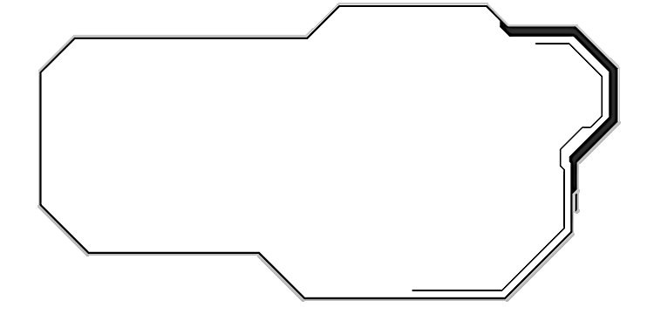


















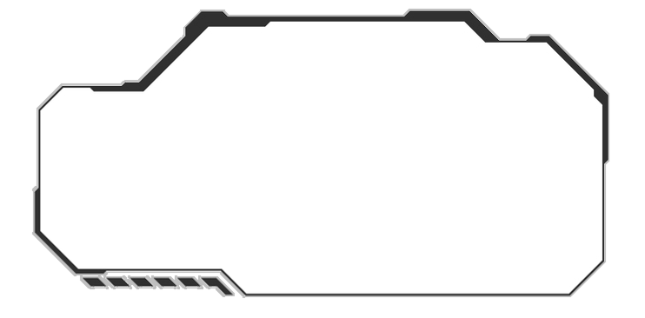
Reality
Infin8te_❖_Realities
Reality
Perspective
Space
Communication
Object
Property
Help
Experience
Time
Object
Property
Help
Hierarchy
Infin8te_❖_Realities
Perspective
Experience
Time
Space
Communication
Hierarchy
Portfolio
Services
Contact
Home
Portfolio
Services
Contact
Home
About Me
Portfolio
About Me
Notes:
# Left Drawer Menus
|- Menu01_

Slide 20
Infin8te_Δ_Realities
Reality
Perspective
Experience
Time
Space
Communication
Object
Property
Help
Home
About Me
Portfolio
Services
Contact
10:28 AM
10:28 AM

Slide 21
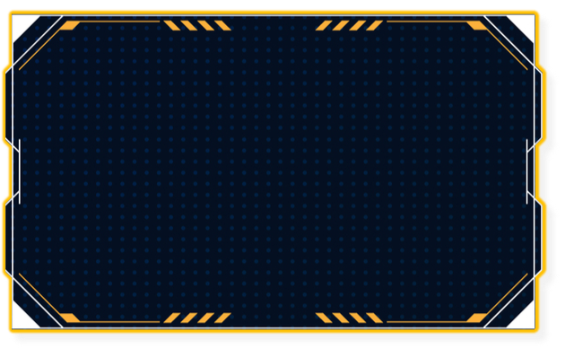
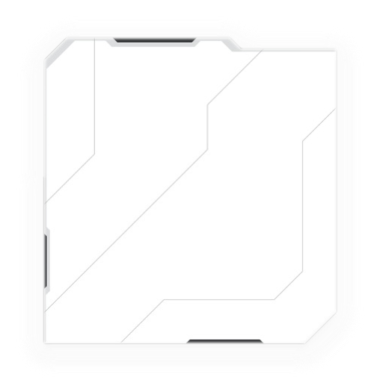
Infin8te_❖_Realities
Reality
Perspective
Experience
Time
Space
Communication
Object
Property
Help
Hierarchy
Home
About Me
Portfolio
Services
Contact

Slide 22


Infin8te_❖_Realities
Reality
Perspective
Experience
Time
Space
Communication
Object
Property
Help
Hierarchy
Infin8te_❖_Realities
Home
About Me
Portfolio
Services
Contact

Slide 23
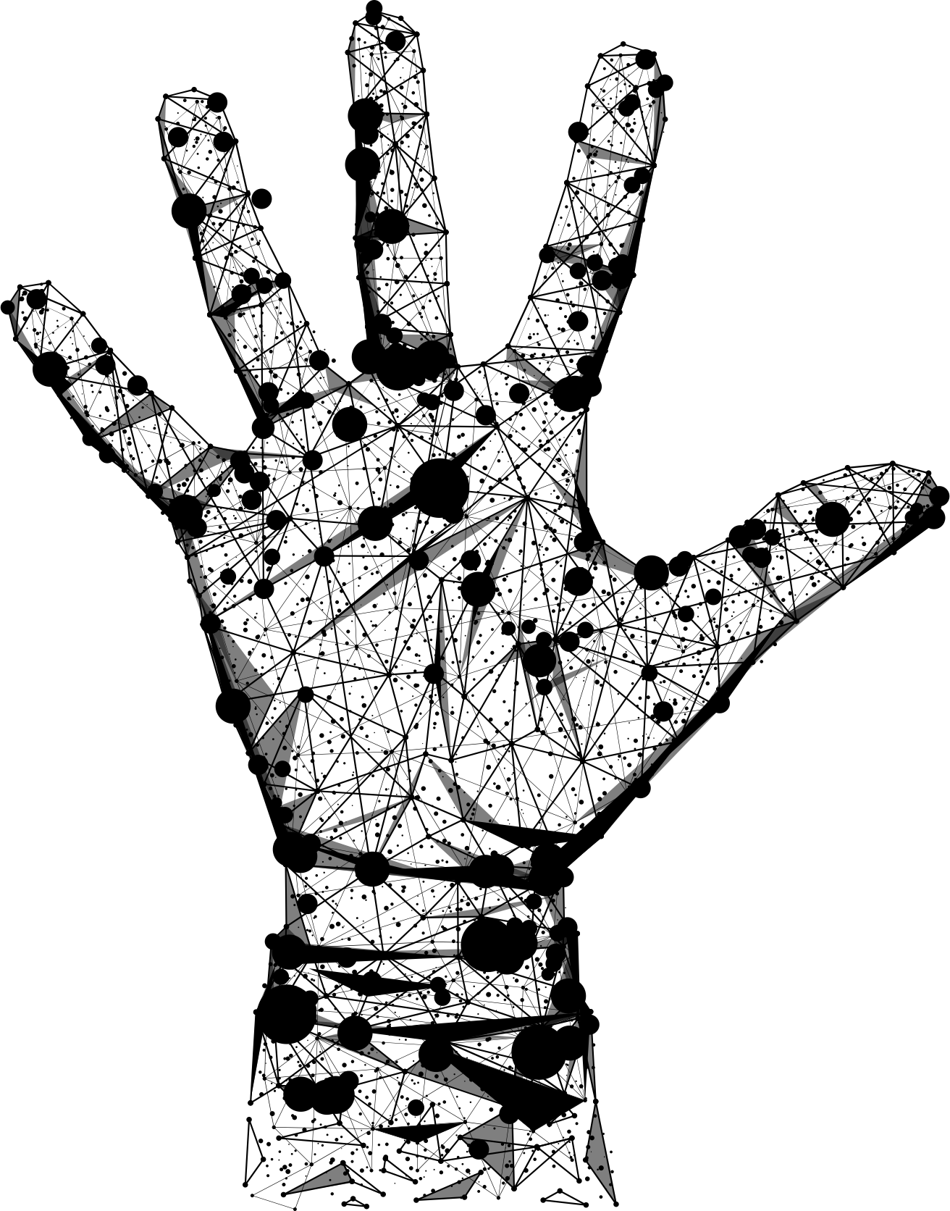

Infin8te_❖_Realities
Reality
Perspective
Experience
Time
Space
Communication
Object
Property
Help
Hierarchy
Infin8te_❖_Realities
Home
About Me
Portfolio
Services
Contact

Slide 25
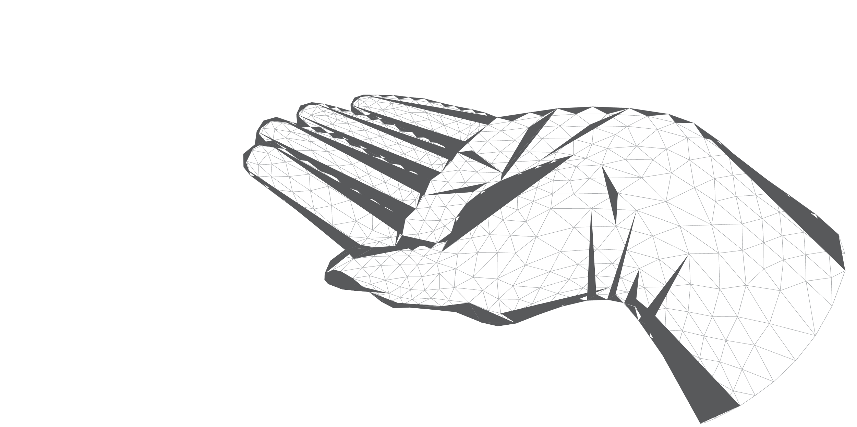

Slide 27


Slide 29
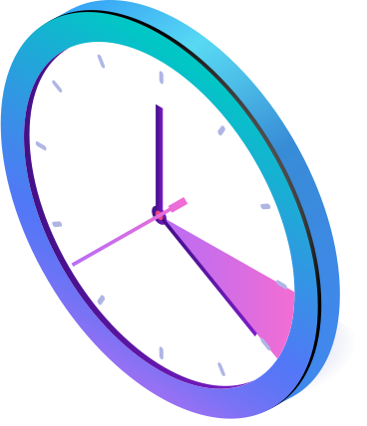

Slide 34




Slide 37
Home
About
Portfolio
Contact
Truths
Falses
Unknowns
Infin8te_Realities
Communication
Experiences
Perspectives
Reality
Time
Space
Objects
Help

